Slide 1

Welcome

Slide 2

Introducing
Name: Md. Jahangir Alam
Assistant Teacher
Ashapur Govt. Primary School
Ghior, Manikganj
Mobile: 01770844115
E-mail: jahangiralam.ru@gmail.com

Slide 3
Identification of Lesson
Class : Four
Subject: English
Title of the lesson: The Lion and the Mouse
Part of the lesson: Lessons 1-2

Slide 4
Learning Outcomes
The students will be able to know:
1. The meaning of the word
2. The spelling of the word
3. Read the text with correct pronunciation
4. Fill the blanks with correct word.

Slide 5
Creating emotion:
Telling a short story:-
About an ant and a leaf

Slide 6


Slide 7
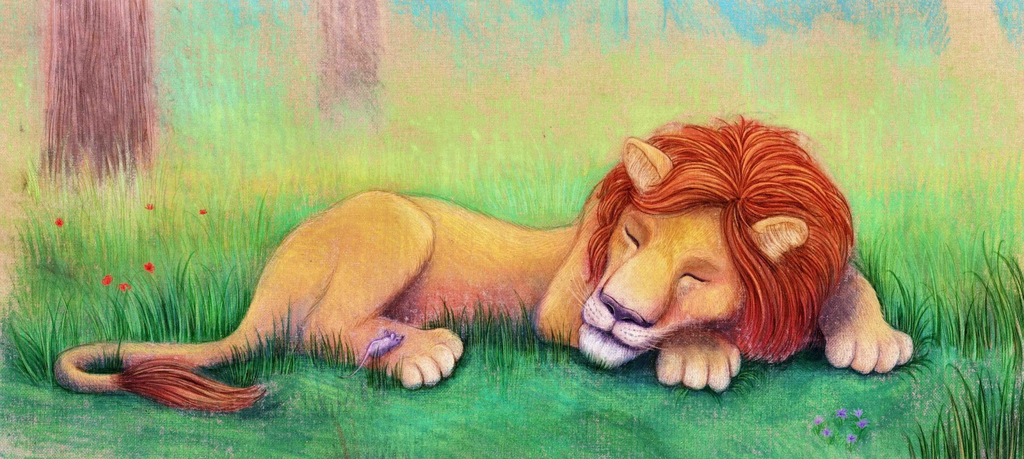
Sleeping

Slide 8
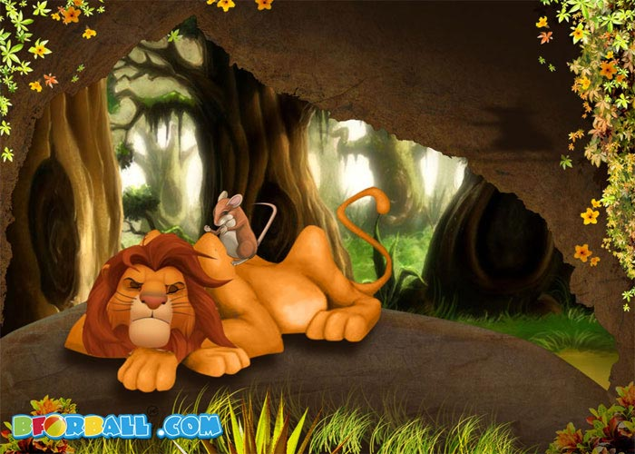
Mouse disturbs the lion

Slide 9
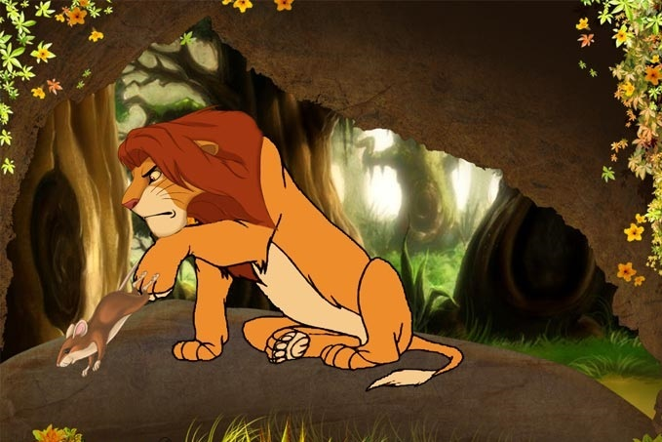
Woke up and caught the mouse

Slide 10
New words:
Lion = সিংহ Mouse = ইঁদুর
Forest = বন Feared = ভয় পেয়েছিল
Woke up = জেগে উঠেছিল Strong= শক্তিশালী

Slide 11
Spelling
Lion = L-i-o-n
Forest = F-o-r-e-s-t
Big = B-i-g
Sleep = S-l-e-e-p

Slide 12
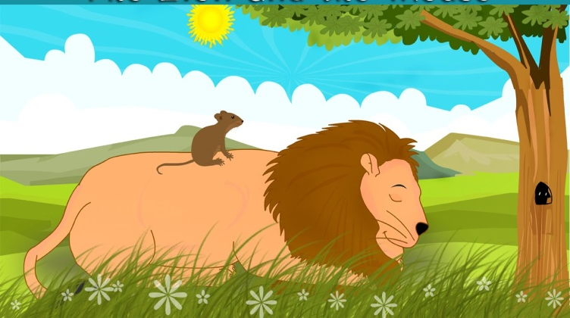
Group work
Look at the picture and write the name
Rose
Lily

Slide 13
Silent Lesson
Please open at page 84 and put your finger under the lines silently.

Slide 14
Evaluation
1.Spell these word: Lion, Forest,Big
2.Write the meaning of these word:
Forest, Strong, Sleeping
Fill in the blanks:
1.One day, a lion was --------.
2.The lion woke ----------.

Slide 15

THANKS ALL

